Slide 1
Capstone Project
Noah Muluberhan-Berhe

Slide 2
West Nile Virus

Slide 3
West Nile Virus: The Disease
West Nile virus is most commonly spread by mosquitoes. Symptoms range from fevers to potentially fatal neurological illnesses.
2002: first human cases reported in Chicago.
By 2004: the City had established a comprehensive surveillance and control program that is still in effect today.

Slide 4
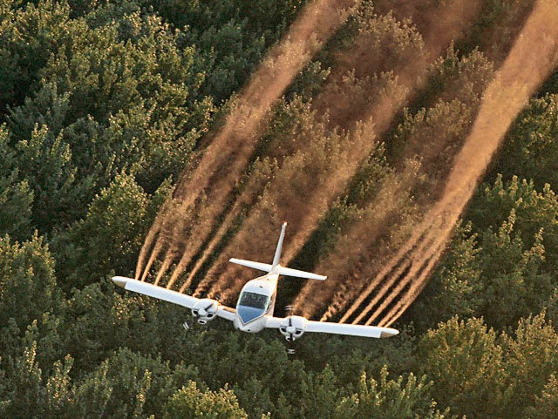
West Nile Virus: The Response
In Chicago: mosquitos in traps across the city are regularly tested for the virus.
The test results influence when and where the city will spray airborne pesticides.

Slide 5
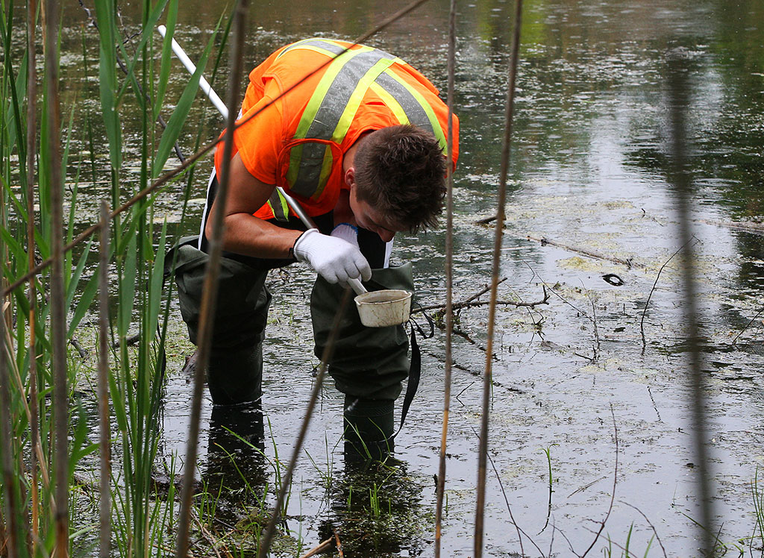
THE CHALLENGE
Given historical test results, and supplementary weather data, can we predict the outcome of these tests?

Slide 6
The Approach
Collect and interrogate the data. Visualise the data.
Compare Machine Learning models.
Conclusions. Further Work
Data Collection
Modelling
Conclusions
Data Preparation
Visualisation
Feature engineering. Ready the data for modelling
Visualise predictions.

Slide 7
The Approach
Collect and interrogate the data. Visualise the data.
Compare Machine Learning models.
Conclusions. Further Work
Data Collection
Modelling
Conclusions
Data Preparation
Visualisation
Feature engineering. Ready the data for modelling
Visualise predictions.

Slide 8
Data Collection 1: Past History
~10k test results from the years 2007, 2009, 2011, and 2013, with information on:
Date
Trap ID
Trap location
Species of Mosquito found
Positive / Negative for West Nile Virus?

Slide 9
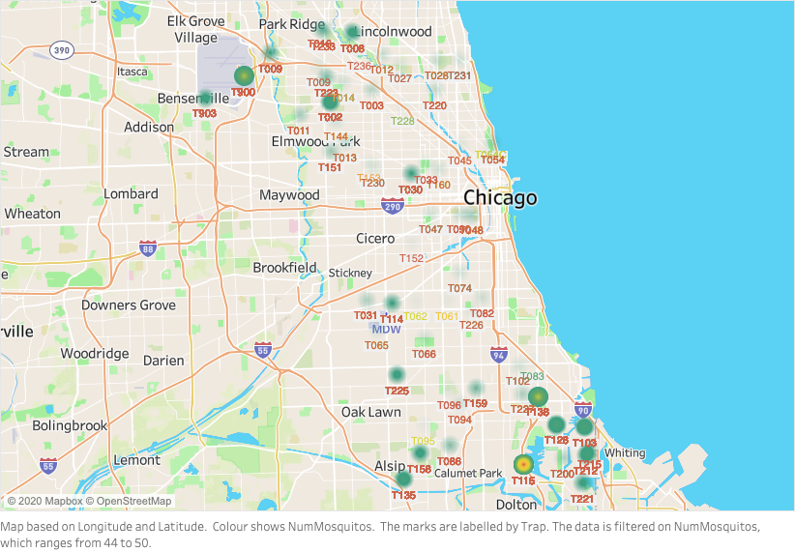
Past History 1: Geography
Standing water is a mosquito breeding ground.
Traps near O’Hare airport in the North and Lake Calumet in the South are more likely to test positive as a result

Slide 10
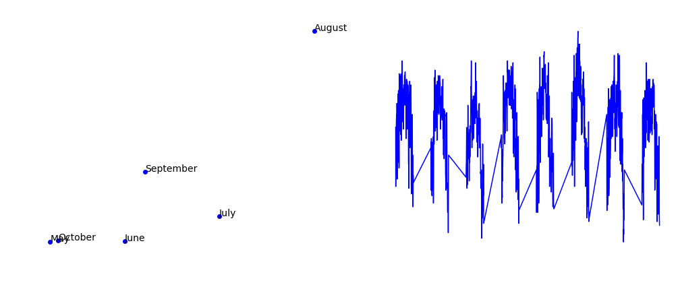
Past History 2: Seasonality
Mosquito numbers and viral incidences follow seasonal patterns
Weather will play an important role in the modelling stage

Slide 11
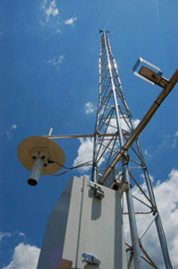
Data Collection 2: Weather
We are provided with daily weather data from NOAA, recorded at two of Chicago’s airports, including:
8 Temperature/Humidity measures
Sunrise, Sunset
Rainfall, Snowfall
4 Wind measure (speed and direction)
Sea-Level information

Slide 12
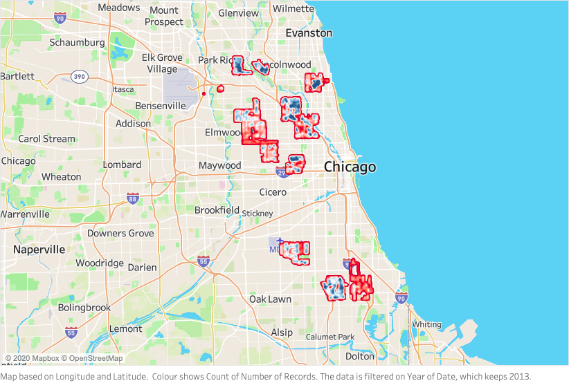
Data Collection 3: Spraying efforts
As airborne spraying can reduce mosquito numbers, we are also provided the time and location of previous efforts.
Efforts were focused over Summer 2013

Slide 13
The Approach
Collect and interrogate the data. Visualise the data.
Compare Machine Learning models.
Conclusions. Further Work
Data Collection
Modelling
Conclusions
Data Preparation
Visualisation
Feature engineering. Ready the data for modelling
Visualise predictions.

Slide 14


Data Preparation: Weather features
Numerous features that carry the same message.
How do we deal with this redundancy without presupposition?

Slide 15
Data Preparation: Principal Components
We can express the data as orthogonal features through Principal Component Analysis (PCA).
Produces PCs descriptive of certain feature groups
Temperatures → PC1

Slide 16
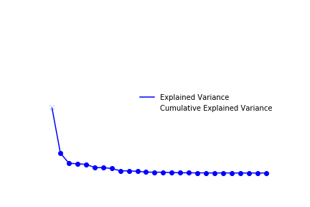
Data Preparation: Principal Components
For the purpose of the modelling later, the Top 10 Principal Components.
Together they explain ~100% of the weather features

Slide 17
The Approach
Collect and interrogate the data. Visualise the data.
Compare Machine Learning models.
Conclusions. Further Work
Data Collection
Modelling
Conclusions
Data Preparation
Visualisation
Feature engineering. Ready the data for modelling
Visualise predictions

Slide 18
Modelling: Overall Approach
Preparing the predictor matrix (X):
Location features: ~130 dummy variables, one for each Trap ID.
Time features: The Top-10 weather-related principal components
Spray feature: Boolean - was that location sprayed at that time?
Tuning parameters:
GridsearchCV() will be used to tune for best parameters with scoring_method = ‘roc_auc’ as this is a binary classification problem
An imblearn pipeline will also be used to deal with class imbalance...

Slide 19
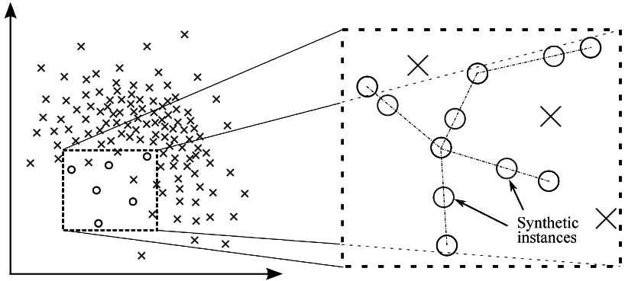
Modelling: Class imbalance
Synthetic Minority Over-Sampling Technique (SMOTE) uses a ‘nearest neighbours’ approach to create synthetic samples.
Random Oversampling creates random samples of the minority class.

Slide 20
Modelling: Class imbalance
Synthetic Minority Over-Sampling Technique (SMOTE-NC) uses a ‘nearest neighbours’ approach to create synthetic samples.
Random Oversampling creates random samples of the minority class.
Large number of categorical features
Continuous features are similar for the minority class
Faster performance when tuning models

Slide 21
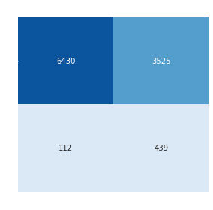
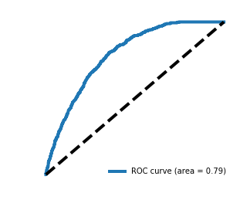
Modelling: Logistic Regression
Logistic Regression performed best with Ridge regularization
High AUC score thanks to the majority class.
Only 11% precision / 19% F1-score in predicting for the virus due to a high number of false negatives

Slide 22
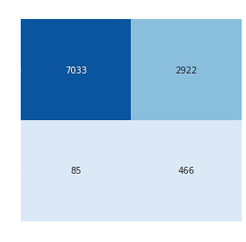
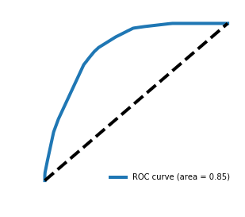
Modelling: Decision Tree Classifier
Decision Tree optimum parameters were a Tree Depth of 9, with 50% of the features being considered at each step.
Similar to Log-Reg:
14% precision / 24% F1-score due to a high number of false negatives
(similar results seen with Random Forests)

Slide 23
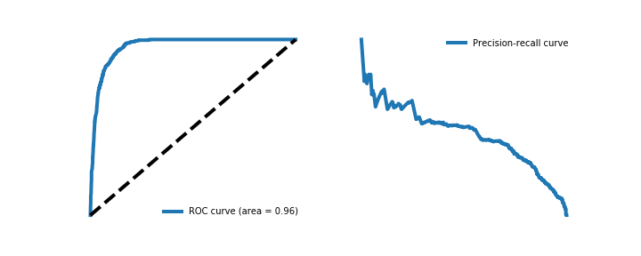
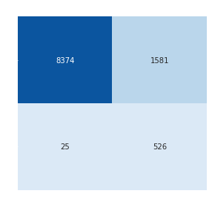
Modelling: Gradient Boosting
Gradient Boosting performed the best out of the ensemble methods, achieving a roc-auc of 96%, and a 25% precision at 50% probability threshold

Slide 24
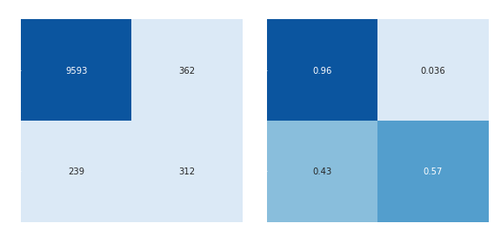
Modelling: Gradient Boosting tuning
Precision improved to 40% after moving to a more stringent threshold of 70%, with F1-score staying at 40%.

Slide 25

The Approach
Collect and interrogate the data. Visualise the data.
Compare Machine Learning models.
Conclusions. Further Work
Data Collection
Modelling
Conclusions
Data Preparation
Visualisation
Feature engineering. Ready the data for modelling
Visualise predictions

Slide 26
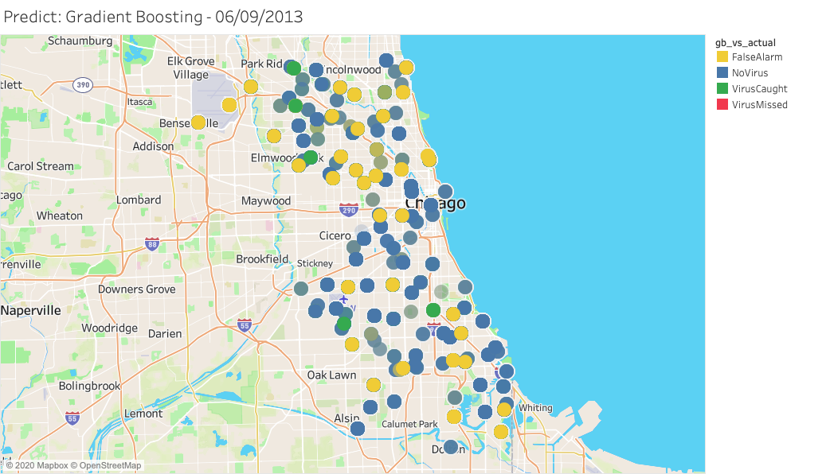
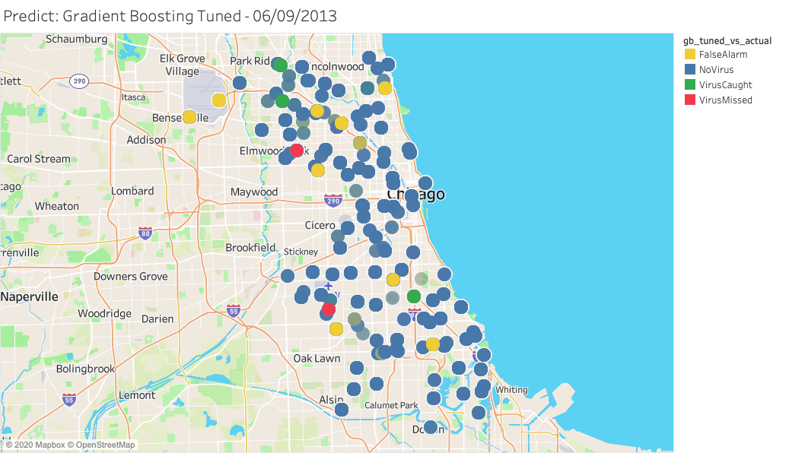
Threshold Tuning performance
The increase in Precision illustrated below, with fewer False Alarms in August 2013 after the move to 70% threshold

Slide 27
The Approach
Collect and interrogate the data. Visualise the data.
Compare Machine Learning models.
Conclusions. Further Work
Data Collection
Modelling
Conclusions
Data Preparation
Visualisation
Feature engineering. Ready the data for modelling
Visualise predictions

Slide 28
Conclusions
Despite regularization efforts, models were better able at predicting the correct time of virus but not the location.
Good performance on GB classifier (ROC-AUC = 96%), however the precision was limited to 40% after tuning the threshold.
The 130 location features introduced when dummifying TrapID introduced too much sparsity, allowing the 10 continuous variables to dominate in the predictions, as can be seen in the Decision Tree visualisation overleaf

Slide 29
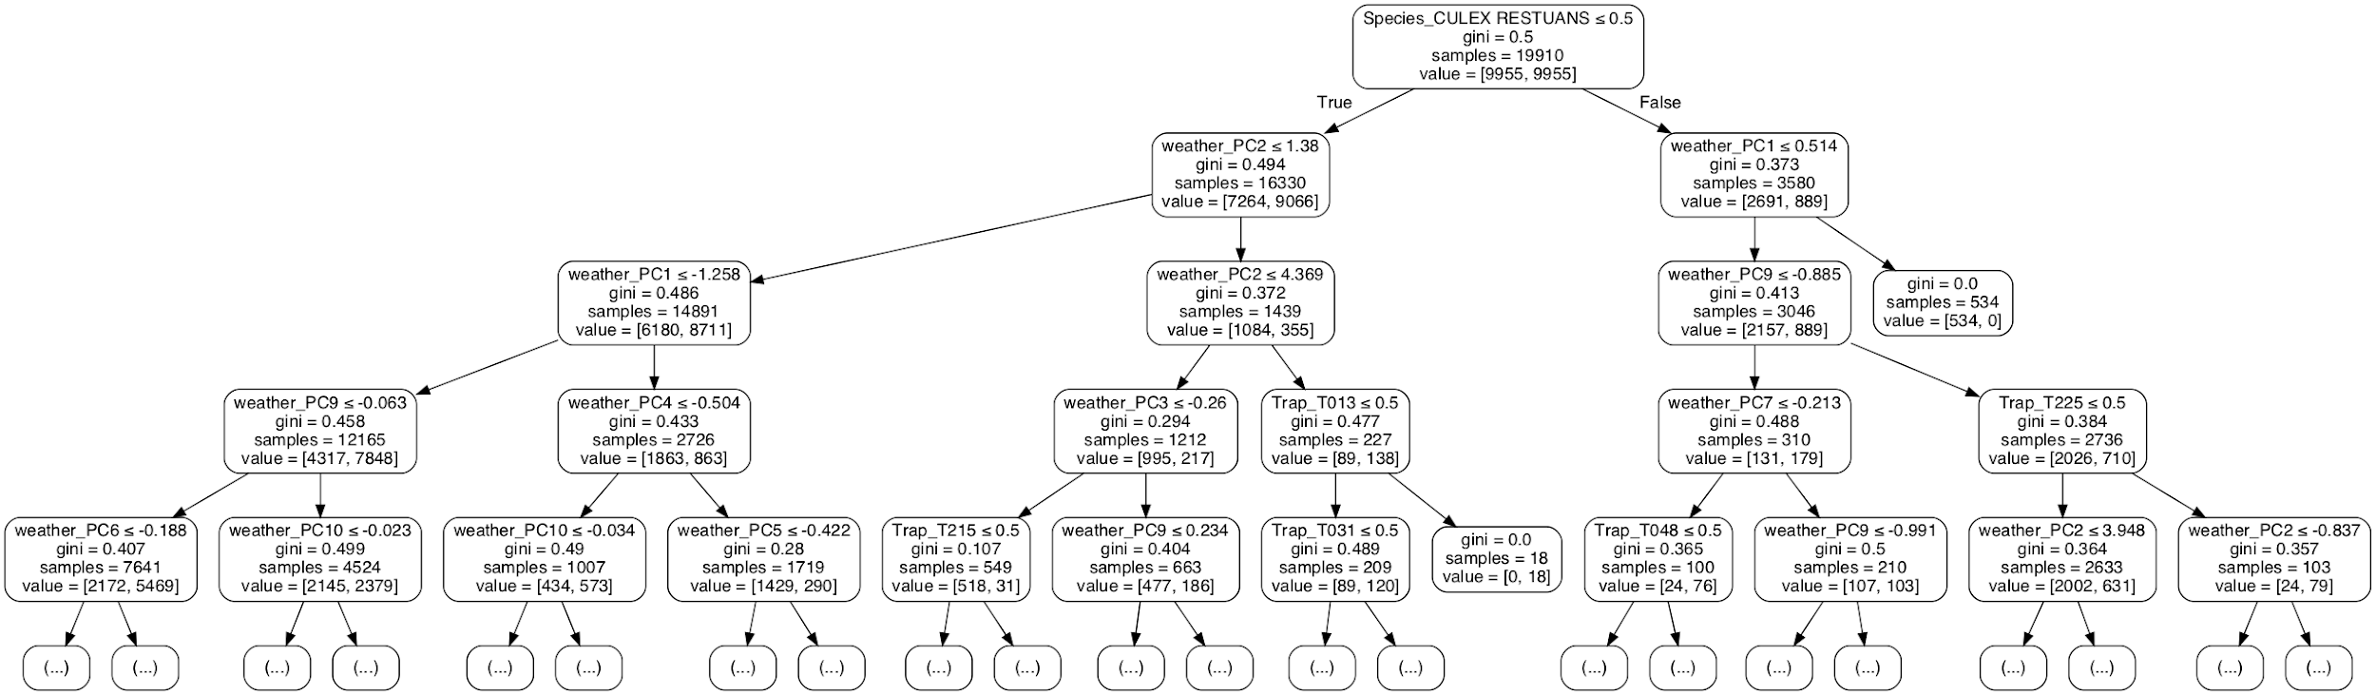
Decision Tree

Slide 30
Next steps
Cluster the Traps based on frequency of observed viruses, to create e.g. ‘High Risk’, ‘Medium Risk’, ‘Low Risk’ groups?
Tune GradBoost further to improve overfitting issues with Kaggle data
Investigate anomaly detection algorithms, and Naive Bayes classifiers
Share Visualisations...

Slide 31
Time for Questions

